Slide 1
VANCOUVER GIS
DRONES: NAVIGATING CERTIFICATION, COMPLIANCE AND OPPORTUNITIES

Slide 2
@COASTAL.KATE
A LITTLE BIT
ABOUT ME
Director of Operations at Coastal Drone
Director on the board of Unmanned Systems Canada and COPA
Commercial airplane pilot
Flight instructor
Aviation since 2007
Drones since 2014
Meteorology nerd

Slide 3
@COASTALDRONE
A LITTLE BIT
ABOUT COASTAL
Started in 2016 as a division of SKY Helicopters
Aerial video and photo
Joined in 2017
Training and consulting
Helping individuals and organizations navigate the drone industry in Canada

Slide 4
WHAT DRONES ARE USED FOR
AND WHAT THEY’LL BE USED FOR NEXT
Notes:
They’re constantly used for trivial applications like saving lives in search and rescue missions, gathering previously unobtainable imagery and data, or minimizing pesticide use in crops. They’re helping introduce a new generation to aviation, and to reintroduce those with lost medicals to the sky- APPALLING! Add in the fact that they’re quiet and convenient for a variety of operations and we have a recipe for failu… wait a minute.

Slide 5
RPAS
A THROWBACK
technology, regulation, technology, regulation, technology, regulation
MODEL AIRCRAFT
FLIGHT CONTROLLERS & CAMERAS
FORMAL REGULATORY FRAMEWORK
WHERE NEXT?
Long history of safe operations in Canada
Self regulated
BVLOS
Autonomy
Large UAS
Cell phone technology
Incorporating RPAS into aviation regulation
Notes:
Technology regulation cycle

Slide 6
Embedding the video made the slideshow too large to send via email so instead, check out the full video at this link.
https://www.ted.com/talks/raffaello_d_andrea_the_astounding_athletic_power_of_quadcopters?language=en

Slide 7
CERTIFICATION REQUIREMENTS FOR DRONE PILOTS
Notes:
Every. single. drone pilot is a reckless ignoramus who is out to wreak havoc on the airspace system. Not a single one considers other airspace users nor has invested hundreds (thousands?) of dollars to undertake extensive ground school training, create procedures, manuals, checklists, get TC approval nor NavCanada authorization. There most certainly aren’t any who are also manned aircraft pilots. And they definitely aren’t just as peeved as you are when they see rogue operators.

Slide 8
AS OF JUNE 2019
DRONE TRAINING
Risk based regulation
Pilot
Product (RPAS)
Procedures
Pilot certificates
Basic
Advanced
Individually held
Online Transport Canada written exam
In-person flight review for advanced category

Slide 9
REQUIREMENTS FOR THE RPAS
Notes:
Drones are increasingly taking jobs from helicopter and fixed wing pilots. These jobs include, but are not limited to: flying next to powerlines, in the tight spaces between buildings, maneuvering close to the ground for movie shoots, low-level surveying and other dull, dirty or dangerous jobs. If we take these jobs away, our bars and pubs will become dangerously low on exaggerated stories of exceptional-piloting-to-avoid-near-death. What will pilots talk about if not themselves?!

Slide 10
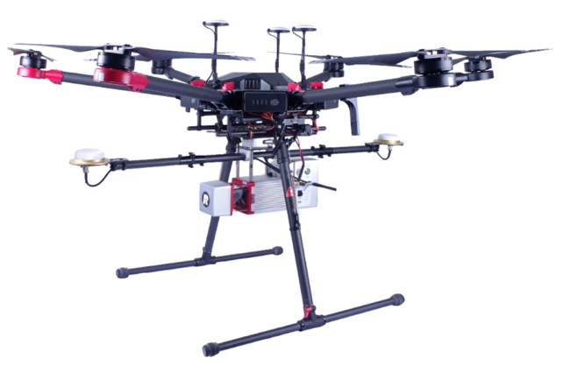
AS OF JUNE 2019
RPAS REQUIREMENTS
Safety Assurance Declarations
Controlled Airspace
Near People
Over People
Over 55 lbs (25kg) drones
SFOC-RPAS

Slide 11
PROCEDURE REQUIREMENTS
Notes:
Drones are increasingly taking jobs from helicopter and fixed wing pilots. These jobs include, but are not limited to: flying next to powerlines, in the tight spaces between buildings, maneuvering close to the ground for movie shoots, low-level surveying and other dull, dirty or dangerous jobs. If we take these jobs away, our bars and pubs will become dangerously low on exaggerated stories of exceptional-piloting-to-avoid-near-death. What will pilots talk about if not themselves?!

Slide 12
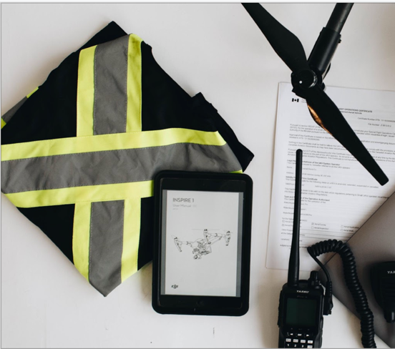
AS OF JUNE 2019
PROCEDURE REQUIREMENTS
Site Survey
Normal Procedures
Emergency Procedures
Incident Recording

Slide 13
THE FUTURE OF AVIATION
OPPORTUNITIES FOR RPAS
Notes:
Drones are increasingly taking jobs from helicopter and fixed wing pilots. These jobs include, but are not limited to: flying next to powerlines, in the tight spaces between buildings, maneuvering close to the ground for movie shoots, low-level surveying and other dull, dirty or dangerous jobs. If we take these jobs away, our bars and pubs will become dangerously low on exaggerated stories of exceptional-piloting-to-avoid-near-death. What will pilots talk about if not themselves?!

Slide 14
RPAS
WHERE WE’RE GOING
+55 +400’
+VLOS
BVLOS
RTM
Widespread
Integrated airspace
Pushing the limits of part 9
Notes:
Technology regulation cycle

Slide 15
QUESTIONS
kate@coastaldrone.co
@coastalkate

Slide 16
Handy Links!
Site Selection Tool (map showing airspace and airports)
https://nrc.canada.ca/en/drone-tool/
Coastal Drone YouTube Channel
https://www.youtube.com/channel/UCTcbrZhnnDw-WhBtrGB1PGQ
Coastal Drone courses
https://coastal-drone-academy.thinkific.com/
Use code “VancouverGIS” for 10% off!

